Slide 1

CUSTOMER REVIEW SENTIMENT ANALYSIS USING NLP & MACHINE LEARNING
Presented By –
Bibhuprasad Das

Slide 2
TABLE OF CONTENTS
01
02
03
04
05
Introduction
Dataset Understanding
Data Cleaning & NLP Preprocessing
Exploratory Data Analysis (EDA)
TF-IDF Vectorization
06
07
08
09
10
Machine Learning Model Building
Model Comparison & Evaluation
Streamlit Dashboard Deployment
Live Sentiment Prediction
Conclusion & Challenges Faced

Slide 3

INTRODUCTION
01
Customer reviews play an important role in understanding user satisfaction, product quality, and customer experience.
With the rapid growth of e-commerce and online platforms, large volumes of customer feedback are generated every day.
Analyzing these reviews manually is difficult, time-consuming, and inefficient. Traditional methods may fail to identify hidden patterns and overall customer sentiment effectively.
In this project, I used Natural Language Processing (NLP) and Machine Learning techniques to analyze customer reviews and automatically classify them into following sentiments.
Positive 😊
Negative 😞
Neutral 😐

Slide 4
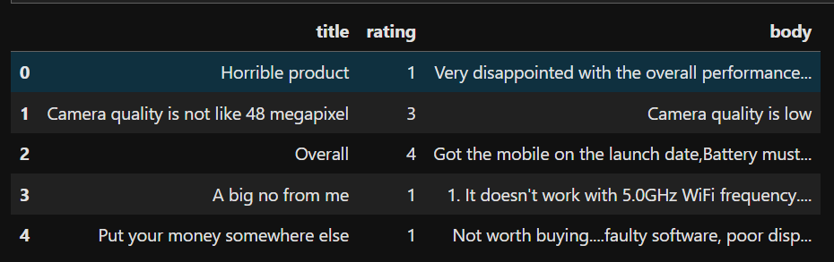
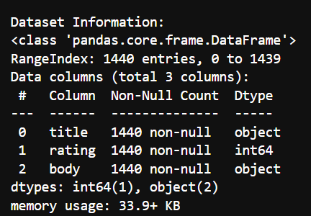
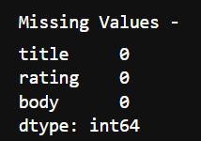

DATASET UNDERSTANDING
02
After loading the dataset, an initial inspection showed that it contains 1440 customer reviews with 3 main features: title, rating, and review body.
The dataset includes customer opinions and ratings related to mobile products, where ratings range from 1 to 5 stars representing different levels of customer satisfaction.
The review text contains valuable feedback regarding battery performance, camera quality, display, pricing, and overall user experience.
The dataset was further inspected for missing values, duplicate records, data types, and review distribution before moving to preprocessing and analysis.

Slide 5
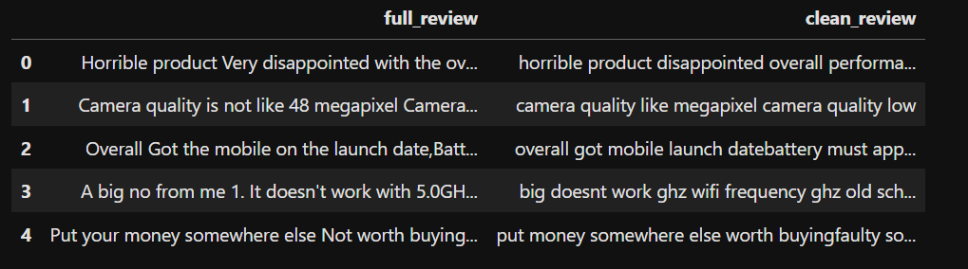
DATA CLEANING & NLP PREPROCESSING
03
Before analysis and model building, several preprocessing steps were applied to improve the quality of the text data.
The title and review body columns were combined to create a complete review for better sentiment understanding.
Text preprocessing techniques such as:
converting text to lowercase,
removing punctuation and special characters,
removing stop words,
and cleaning unwanted text
were performed using NLP techniques.
Additional features such as word count, character count, and sentiment labels were also created for exploratory analysis and machine learning.
These preprocessing steps helped prepare clean and structured text data for feature extraction and model training.
Raw Review
Lowercasing
Remove Special Characters
Remove Stopwords
Clean Review

Slide 6
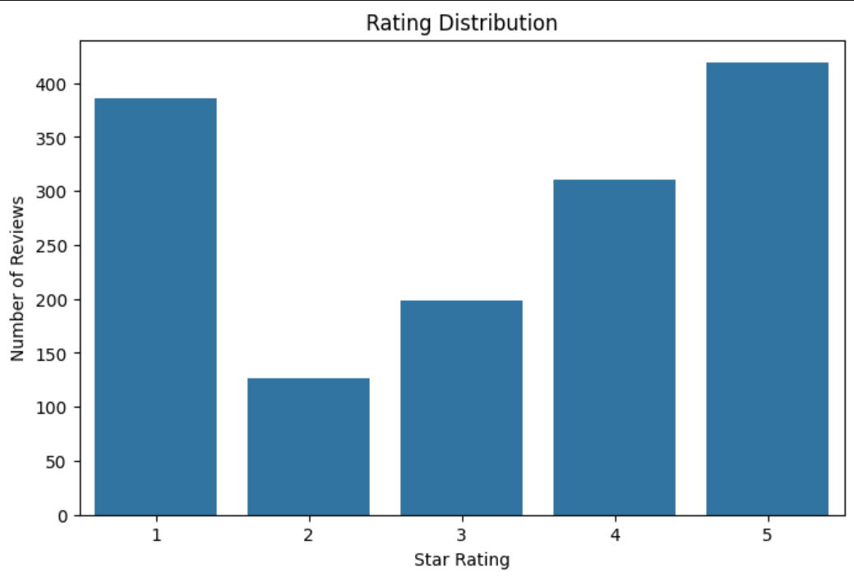
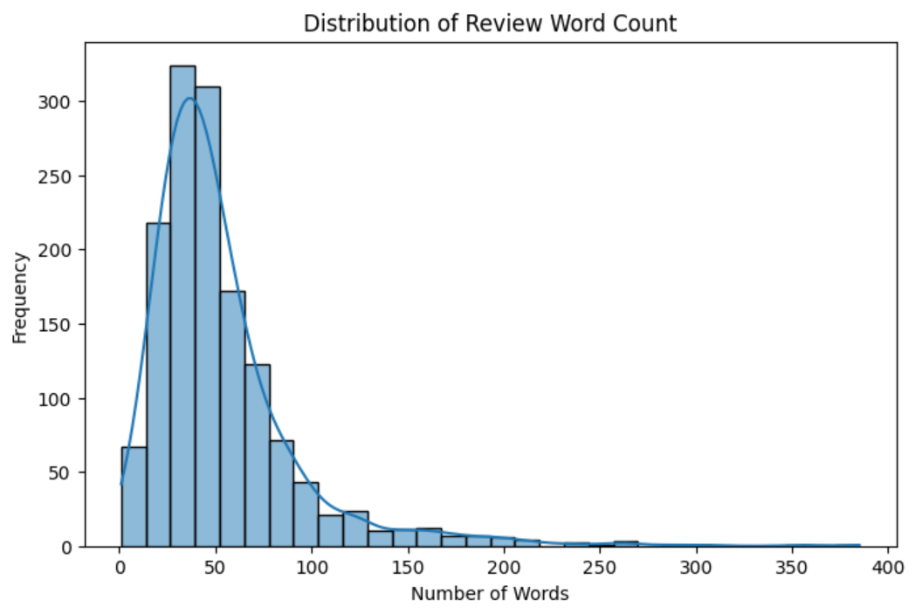
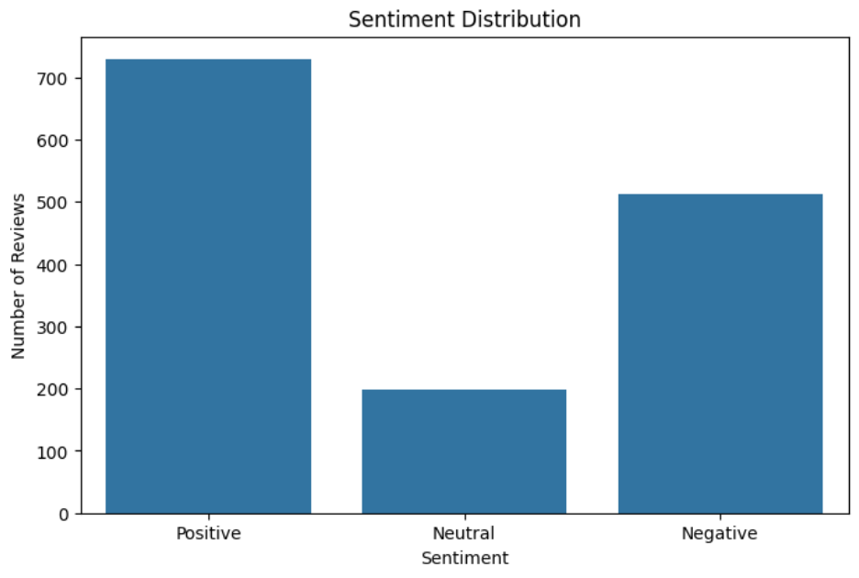
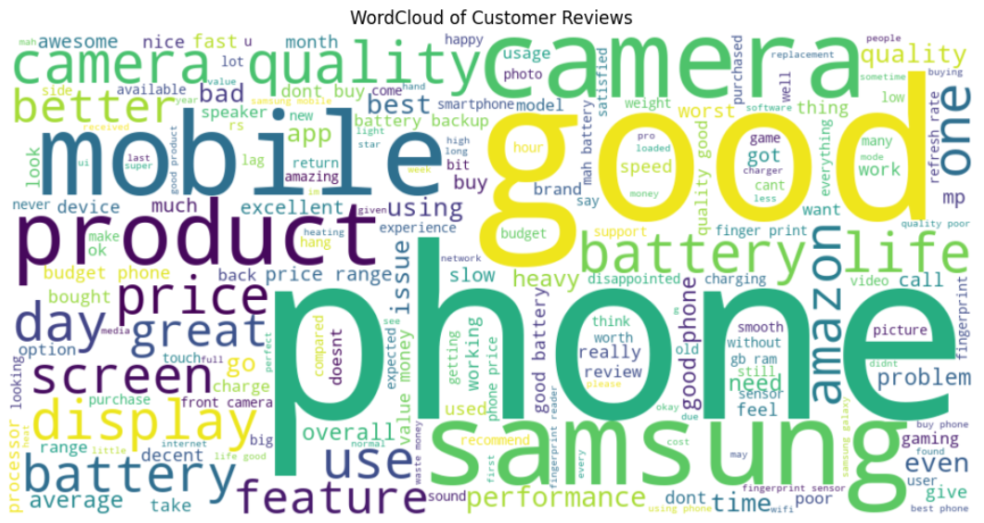
EXPLORATORY DATA ANALYSIS (EDA)
04
After preprocessing the review data, exploratory data analysis was performed to better understand customer opinions and review behavior.
Various visualizations were created to analyze:
rating distribution,
review length patterns,
sentiment distribution,
frequently used words in reviews.
EDA helped identify important customer trends and commonly discussed product features before building machine learning models.

Slide 7
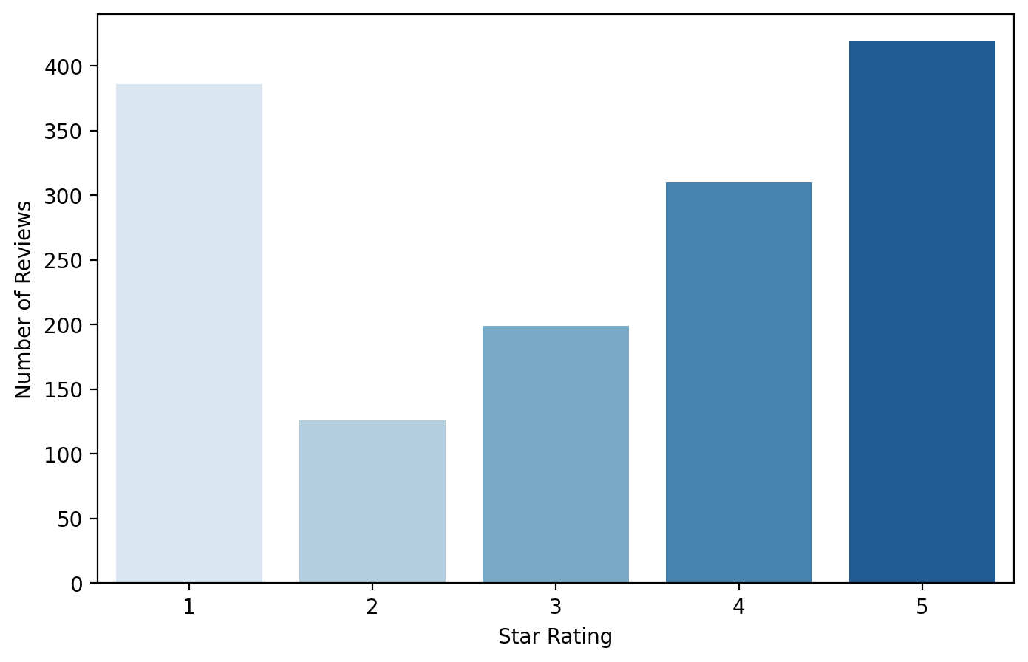
RATING DISTRIBUTION ANALYSIS
03
05
The rating distribution plot was used to analyze customer satisfaction levels based on review ratings from 1 to 5 stars.
The analysis showed that:
5-star ratings were the most frequent,
while 1-star ratings were also significant,
indicating both positive and negative customer experiences.
This visualization helped understand the overall opinion distribution within the dataset before sentiment modeling.
Rating | Count
1 | 386
2 | 126
3 | 199
4 | 310
5 | 419

Slide 8
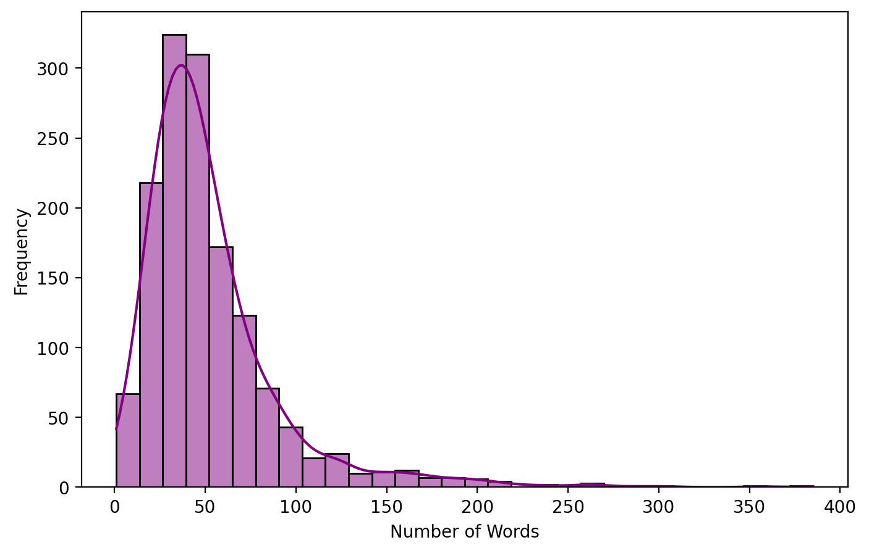
REVIEW WORD COUNT ANALYSIS
06
The review word count distribution was analyzed to understand customer review length and writing behavior.
The histogram shows that most customer reviews contain approximately 20 to 60 words, while only a few reviews are very short or extremely lengthy.
This analysis helped identify the overall review pattern and supported further NLP preprocessing and feature engineering.

Slide 9
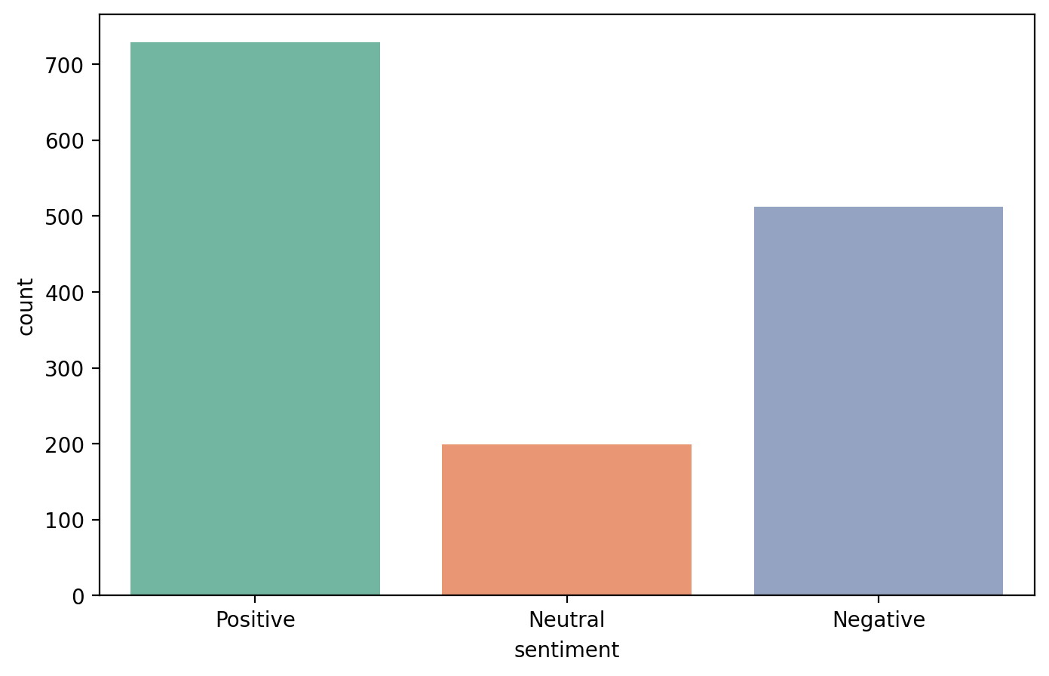
SENTIMENT DISTRIBUTION ANALYSIS
07
Customer reviews were categorized into:
Positive,
Negative,
Neutral sentiments
based on rating values.
The sentiment distribution analysis showed that Positive reviews were dominant in the dataset, indicating overall customer satisfaction with the product.
Negative reviews were also significant, while Neutral reviews were comparatively fewer.
This visualization helped understand the balance of sentiment classes before machine learning model training.

Slide 10
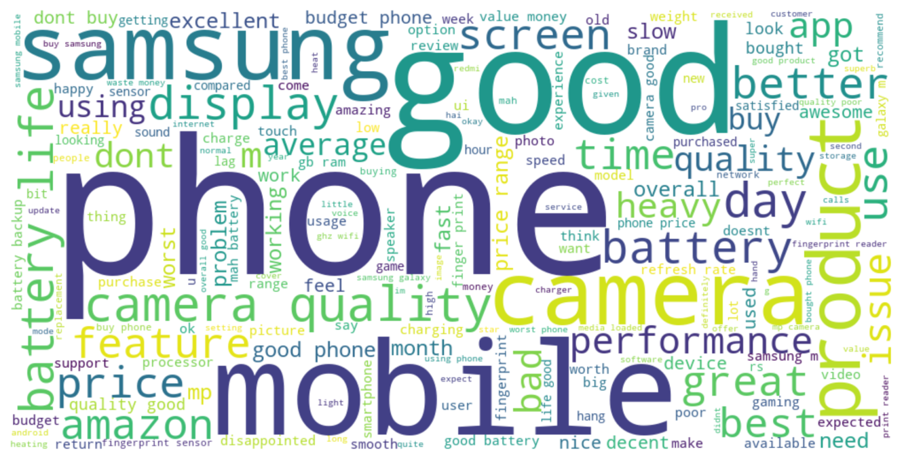
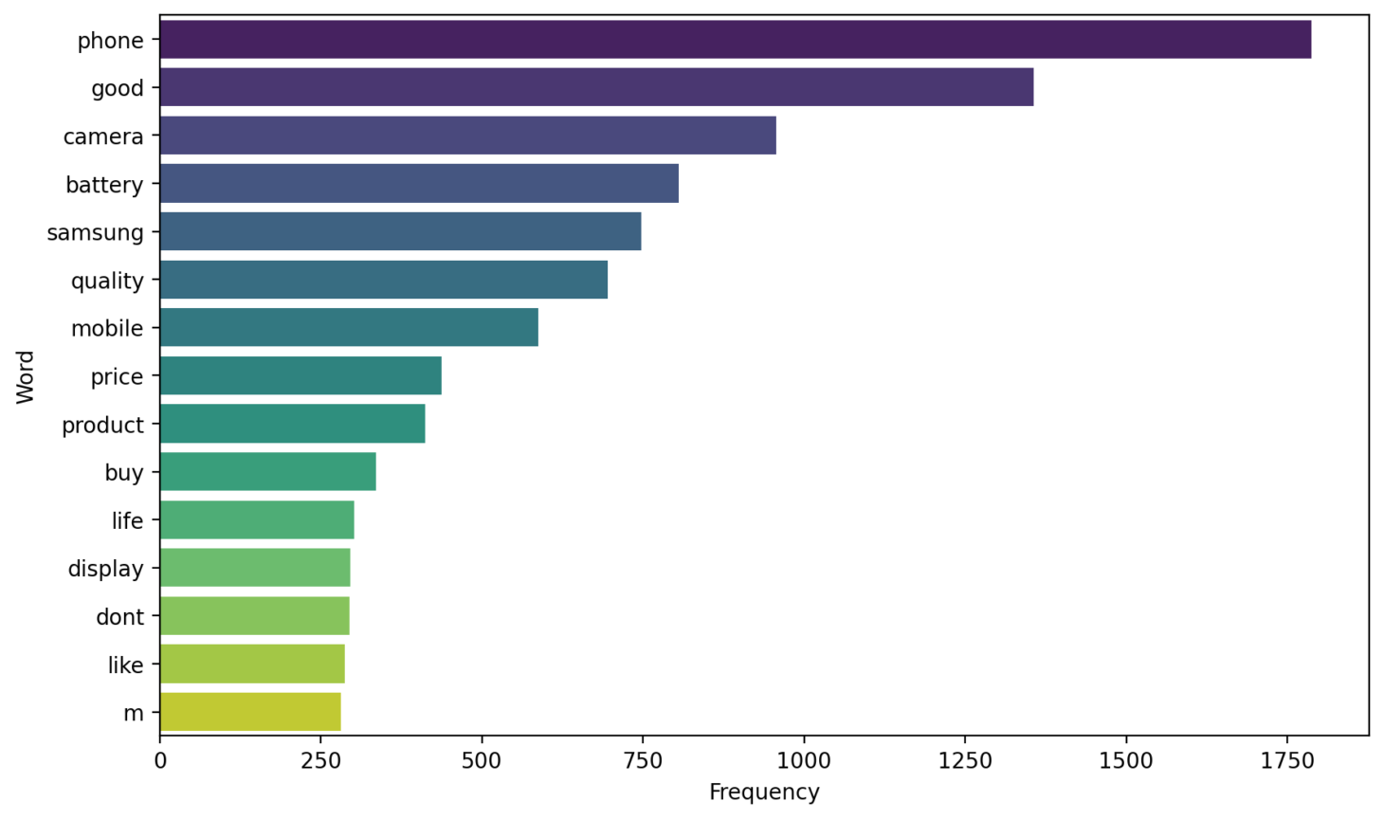
WORDCLOUD & FREQUENT WORD ANALYSIS
08
Word frequency analysis and Word Cloud visualization were used to identify commonly discussed topics in customer reviews.
Frequently used words such as:
battery,
camera,
quality,
mobile,
price
highlight the key product features customers focus on most.
The Word Cloud visually represents important terms, where larger words indicate higher frequency in the dataset.
This analysis helped identify major customer discussion trends and product concerns.

Slide 11

TF-IDF VECTORIZATION
09
After preprocessing the review text, TF-IDF (Term Frequency–Inverse Document Frequency) vectorization was applied to convert textual data into numerical form for machine learning.
TF-IDF measures the importance of words in a review relative to the entire dataset.
Frequently occurring but meaningful words receive higher importance, while very common words receive lower importance.
The cleaned reviews were transformed into numerical feature vectors, which were then used for training machine learning models for sentiment classification.
01
02
03
04
Clean Reviews
TF-IDF Vectorization
Numerical Feature Matrix
Machine Learning Models

Slide 12
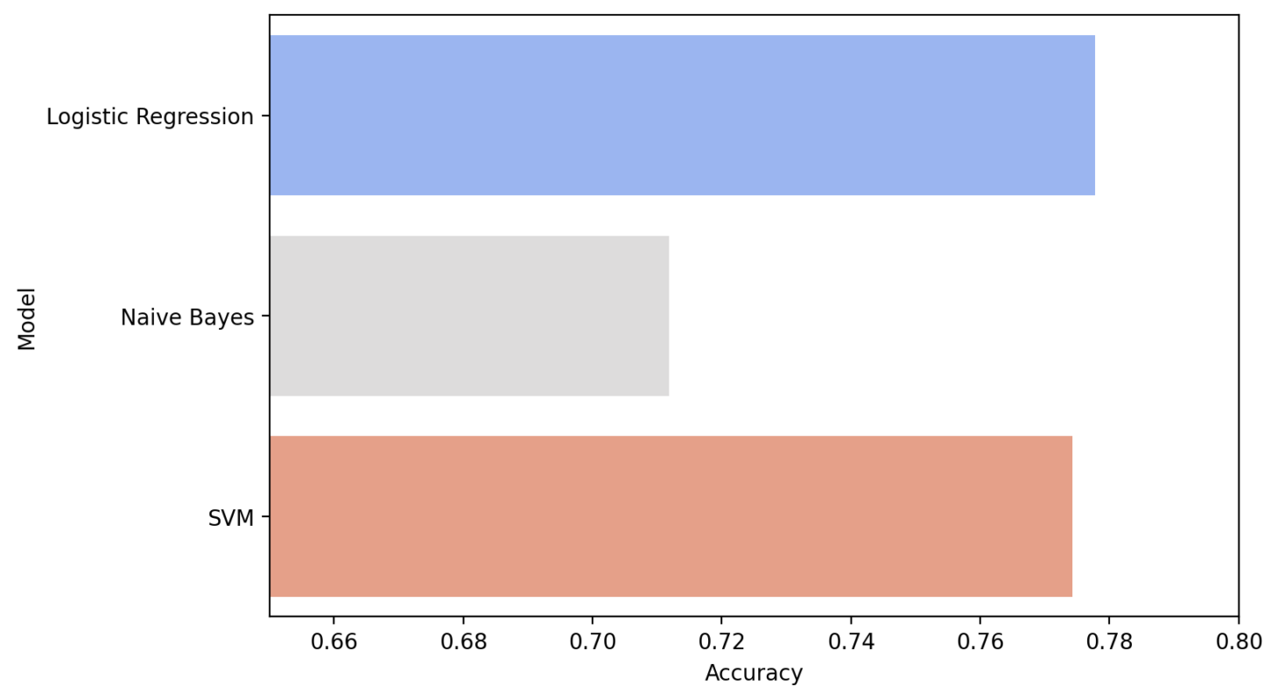

MACHINE LEARNING MODELS & MODEL COMPARISON
10
After TF-IDF vectorization, multiple machine learning models were trained to classify customer reviews into Positive, Negative, and Neutral sentiments.
The dataset was divided into training and testing sets before model training and evaluation.
The following models were implemented:
Logistic Regression
Naive Bayes
Support Vector Machine (SVM)
Each model was evaluated using accuracy and classification performance metrics to identify the best-performing sentiment classification model.
Among all models, Logistic Regression achieved the highest accuracy and was selected as the final model for deployment.
Model | Accuracy
Logistic Regression | 0.7778
Naive Bayes | 0.7118
Support Vector Machine | 0.7743

Slide 13
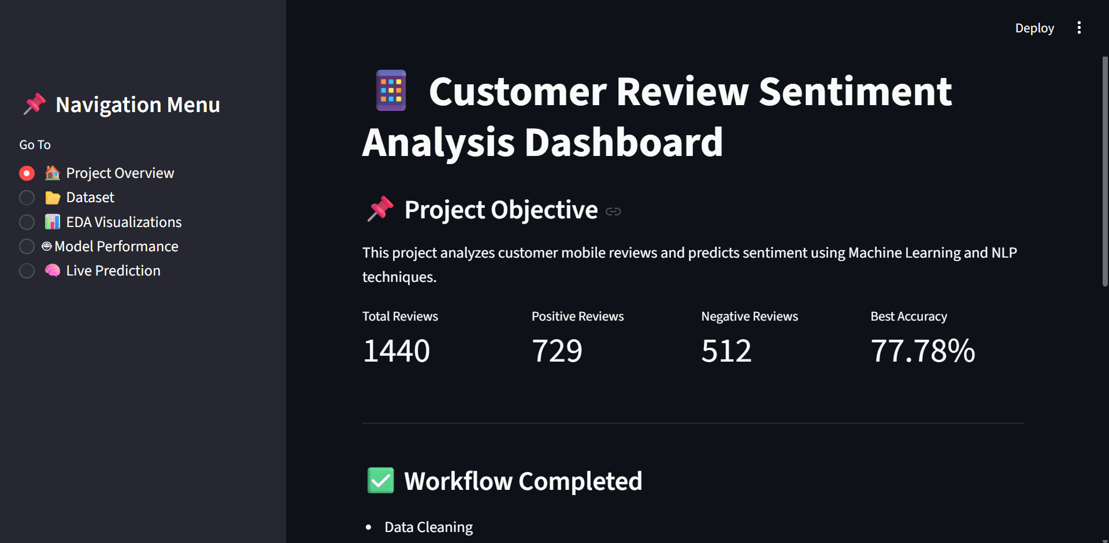
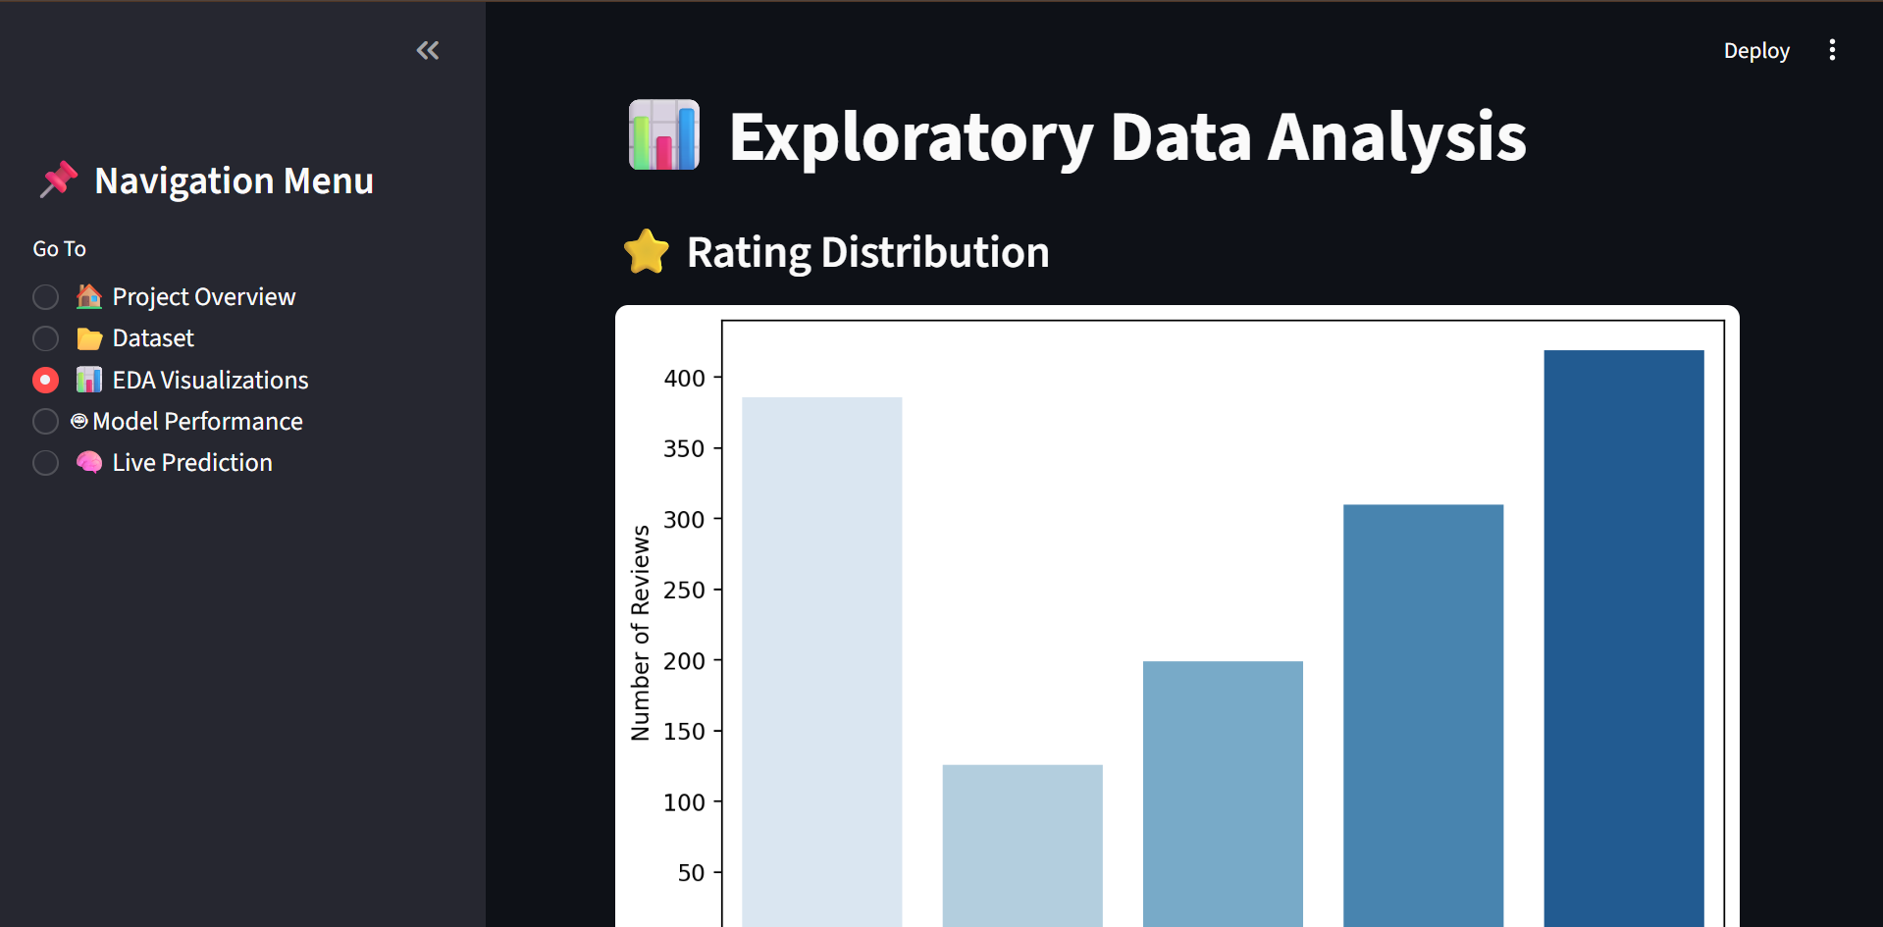
STREAMLIT DASHBOARD DEPLOYMENT
11
After selecting the best-performing model, the project was deployed using Streamlit to create an interactive web-based dashboard.
The dashboard includes:
project overview,
dataset information,
EDA visualizations,
model performance analysis,
real-time sentiment prediction.
The deployment allows users to interact with the system and analyze customer reviews dynamically through a user-friendly interface.
This step transformed the machine learning model into a practical and interactive application.

Slide 14
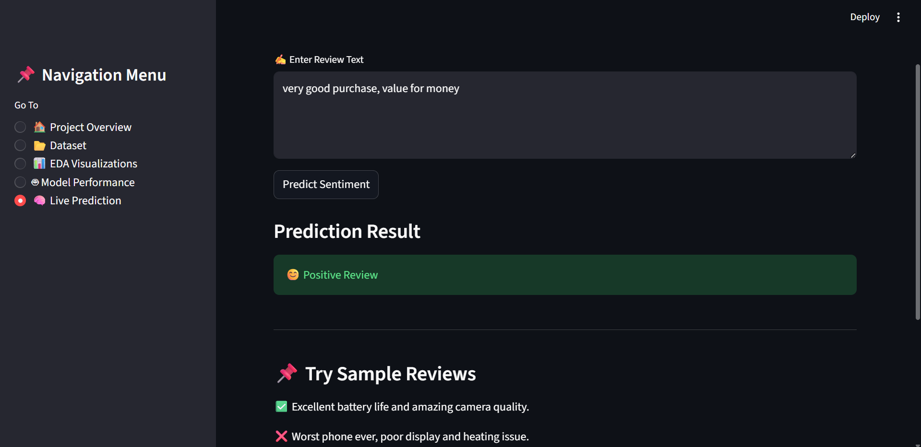
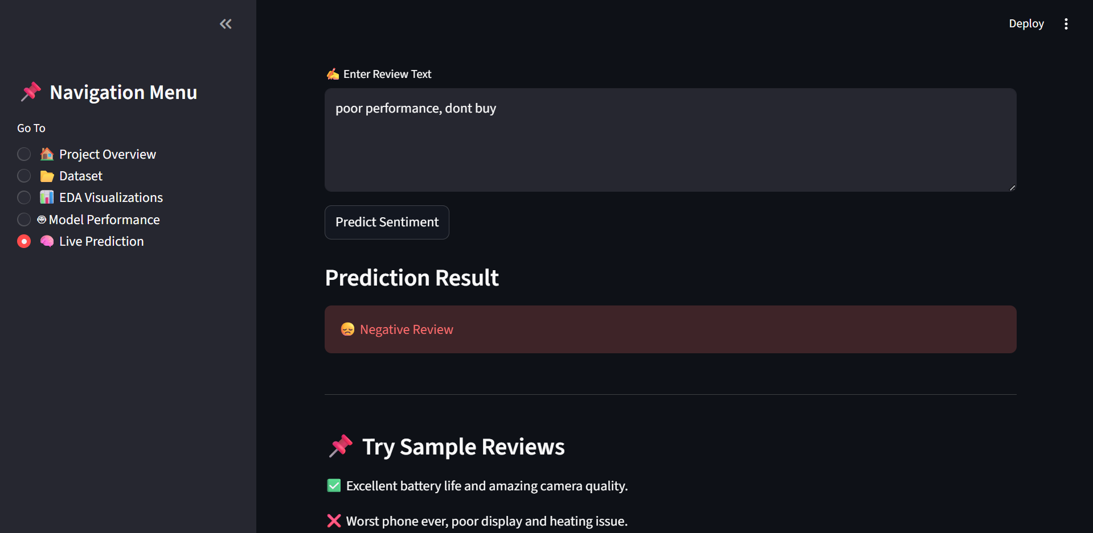
LIVE SENTIMENT PREDICTION
09
12
The deployed dashboard provides a real-time sentiment prediction feature where users can enter customer reviews and instantly receive sentiment classification results.
The input review is:
preprocessed using NLP techniques,
transformed using the saved TF-IDF vectorizer,
classified using the trained Logistic Regression model.
The system predicts whether the review sentiment is:
Positive,
Negative,
Neutral.
This feature demonstrates the practical implementation of NLP and machine learning in real-world applications.

Slide 15
CONCLUSION &
CHALLENGES FACED
13
Conclusion
Customer reviews were successfully analyzed using NLP and Machine Learning techniques.
Text preprocessing and exploratory data analysis helped understand customer sentiment patterns.
TF-IDF vectorization was used to convert text data into numerical features for model training.
Multiple machine learning models were implemented and compared for sentiment classification.
Logistic Regression achieved the highest accuracy of 77.78% and was deployed using Streamlit.
Challenges Faced
Cleaning unstructured review text was one of the major challenges.
Converting text into numerical features using TF-IDF required proper preprocessing.
Neutral reviews were comparatively harder to classify accurately.
Deploying the complete dashboard using Streamlit also required integration of multiple components.

Slide 16


